Slide 1
Firmware Update Strategies for Embedded Systems
Presented by:
Rahul Chowdary Pinnaka
Mat No : 621023
Branch : M.Sc. Embedded Systems
Name of the supervisors:
Dipl.-Ing. Daniel Froß
Dr.-Ing. Marko Rößler

Slide 2
Introduction
Motivation
Project statement and tasks
Literature survey
Hardware details
Project plan
Project timeline
References
Agenda

Slide 3
Wireless communication systems are utilized for a wide variety of applications
  Ex: Home automation and simple sensor networks etc.
What is firmware ?
  Firmware is a software that makes hardware work and do what its manufacturer intended it to do.
Need for firmware update ?
Introduction

Slide 4
Digitalization is ruling the world so as the digital devices
Firmware is not completely perfect during initial design
Bugs must be fixed over the time
New functionalities may be added
Firmware may not satisfy client requirements anymore
Motivation

Slide 5
Statement
Firmware update strategies for embedded systems
Tasks
Surveying firmware update strategies in embedded systems. Evaluation towards aspects such as
  Hardware/software requirements
  Applicable during normal operation/offline
  Wired/over the air (OTA) firmware data exchange
  Fault tolerance/backup strategies
Selection of one method applicable to a given embedded system (e.g. DWM1001) with restricted memory/computation capabilities
Prototypical implementation and test of the selected method on the given system
Documentation/discussion of results
Project statement and tasks

Slide 6
Wired firmware updates | Wireless (OTA) firmware updates
Firmware data transfer medium can be USB, UART, Ethernet cable etc. | Firmware data transfer medium can be Bluetooth, Internet etc.
Introduces more device offline time | Introduces less device offline time from normal operation
Generally fault tolerance strategies are not required | Fault tolerance strategies such as cryptographic algorithms are required
Backup strategy is possible to retrieve the old firmware incase of fault occurrence during activation of new firmware by designing efficient bootloader using dual bank update mechanism | Backup strategy is possible to retrieve the old firmware incase of fault occurrence during activation of new firmware by designing efficient bootloader using dual bank update mechanism
More flash memory and RAM are required to implement firmware update with backup strategy | More flash memory and RAM are required to implement firmware update with backup strategy
Generally cryptographic accelerators are not required | Cryptographic accelerators are required to support cryptographic algorithmic operations
Literature survey
Table 1: Wired firmware updates vs wireless firmware updates

Slide 7
Literature survey
Fig 1: Single bank firmware update mechanism
Fig 2: Dual bank bank firmware update mechanism

Slide 8
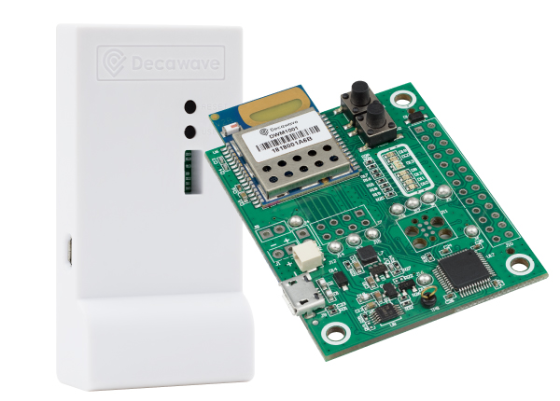
Hardware details
Product use
Mainly used for real time location services (RTLS)
Product features
Features the DW1000 transceiver IC and Nordic Semiconductor nRF52832 MCU
On-board Bluetooth for wireless connectivity
64 kB RAM and 512 kB ROM
Applications
Asset tracking, navigation, factory automation, security, and consumer applications
Fig 3: DWM1001 development kit

Slide 9
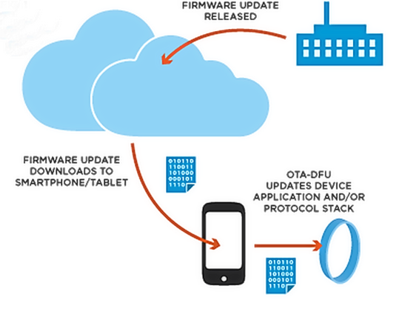
Project plan
Proposed method
Over the air (OTA) firmware update using bluetooth functionality present in DWM1001 module.
Terms
Bootloader: Software program which accepts firmware package over the air and activates it on the microcontroller.
DFU – Device firmware update
Fig 4: OTA firmware update process

Slide 10
Start
Literature survey, understanding project tasks and familiarization with hardware
Project plan
Bootloader development for OTA firmware update using Bluetooth
Test bootloader ?
No
Yes
Implement and verify OTA firmware update in DWM1001 module
Update successful ?
No
Yes
Fig 5: Flow chart of the project plan
End

Slide 11
Project timeline
Week | Date | Planned work | Status
1 - 2 | 15.10.2020 – 25.10.2020 | Understand project statement and tasks to be performed. Initial research about the project. | Completed
3 – 5 | 26.10.2020 – 09.11.2020 | Literature survey and preparation for concept presentation. Familiarization with hardware. | Completed
5 | 10.11.2020 | Concept presentation | Ongoing
5 - 8 | 11.11.2020 – 29.11.2020 | Bootloader development and testing. | Yet to be completed
9 - 12 | 30.11.2020 – 27.12.2020 | Implementation of update process over the air (OTA) and start of documentation. | Yet to be completed
13 | 28.12.2020 – 03.01.2021 | Testing of the update process and total project. | Yet to be completed
14 | 04-01.2021 – 10.01.2021 | Final report drafting and submission for review. | Yet to be completed
15 | 11.01.2020 – 17.01.2021 | Addressing the comments on first draft of the report and preparation for final presentation. | Yet to be completed
16 - 17 | 18-01.2021 – 26.01.2021 | Final presentation preparation | Yet to be completed
18 | 27.01.2020 | Final submission of report | Yet to be completed
Table 2: Project timeline

Slide 12
Pingale, P., Amrutkar, K. and Kulkarni, S., 2016, May. Design aspects for upgrading firmware of a resource constrained device in the field. In 2016 IEEE International Conference on Recent Trends in Electronics, Information & Communication Technology (RTEICT) (pp. 903-907). IEEE.
Kachman, O. and Balaz, M., 2020, April. Efficient Patch Module for Single-bank or Dual-bank Firmware Updates for Embedded Devices. In 2020 23rd International Symposium on Design and Diagnostics of Electronic Circuits & Systems (DDECS) (pp. 1-6). IEEE.
Asokan, N., Nyman, T., Rattanavipanon, N., Sadeghi, A.R. and Tsudik, G., 2018. ASSURED: Architecture for secure software update of realistic embedded devices. IEEE Transactions on Computer-Aided Design of Integrated Circuits and Systems, 37(11), pp.2290-2300.
Anton, O., Gelineau, B. and Sauget, J., 2012. Firmware and bootloader.
https://infocenter.nordicsemi.com/index.jsp?topic=%2Fcom.nordic.infocenter.nrf52832.ps.v1.1%2Fmemory.html
https://www.decawave.com/product/mdek1001-deployment-kit/
https://www.decawave.com/product/dwm1001-module/
References

Slide 13
Thank you
for your
attention

